Slide 1
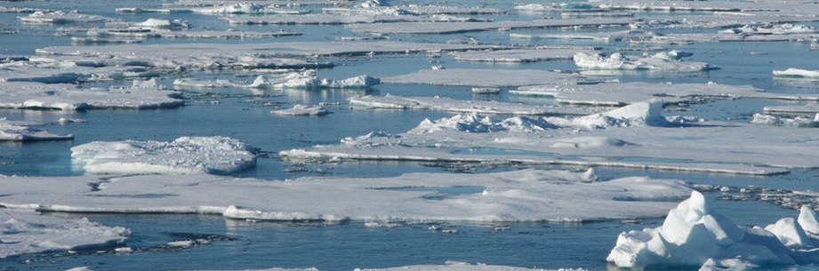
Sea Ice results and Iceberg water flux scheme in ACCESS-CM2
Siobhan O’Farrell, Dave Bi, Climate Science Centre

Slide 2
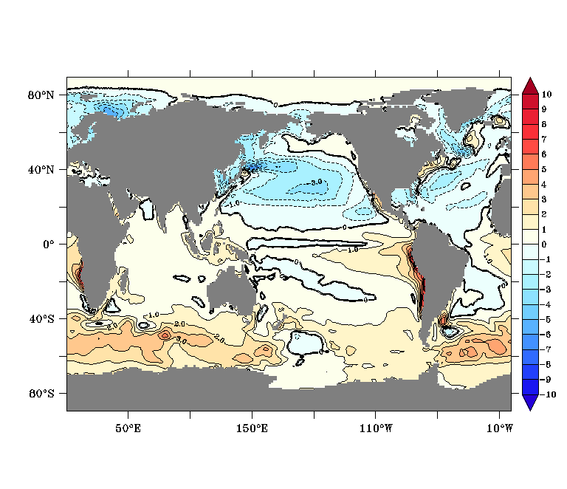
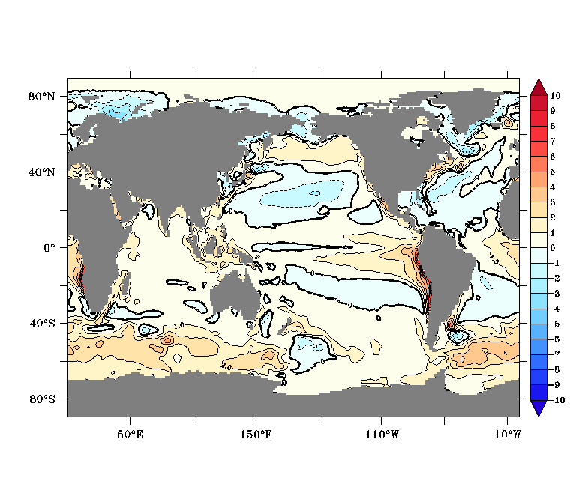
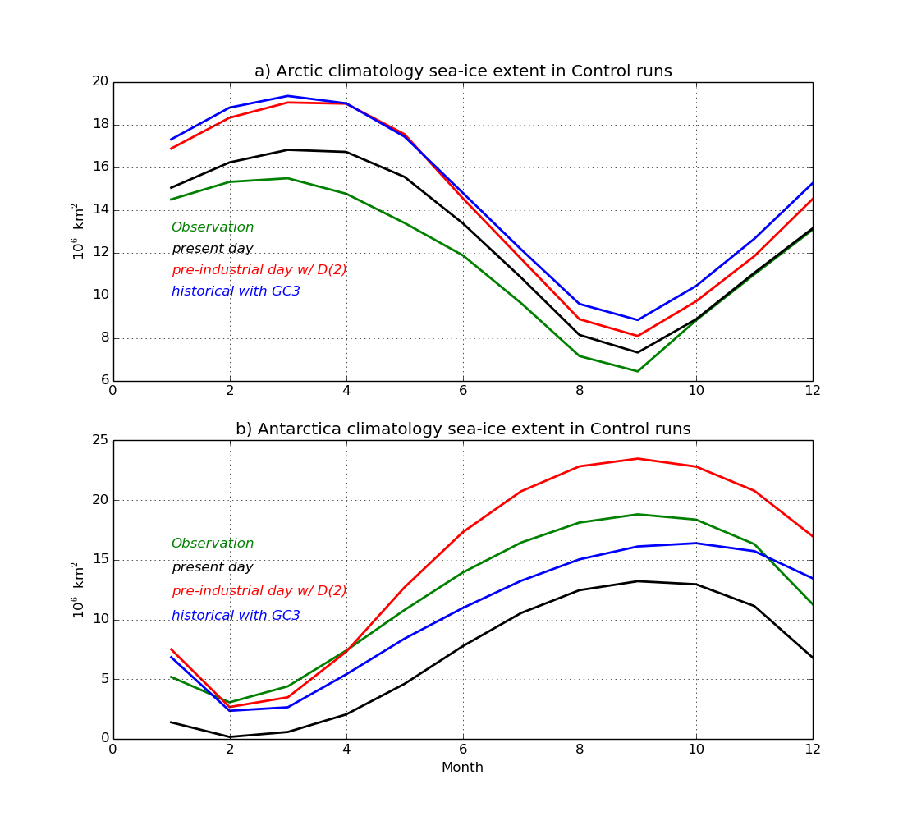
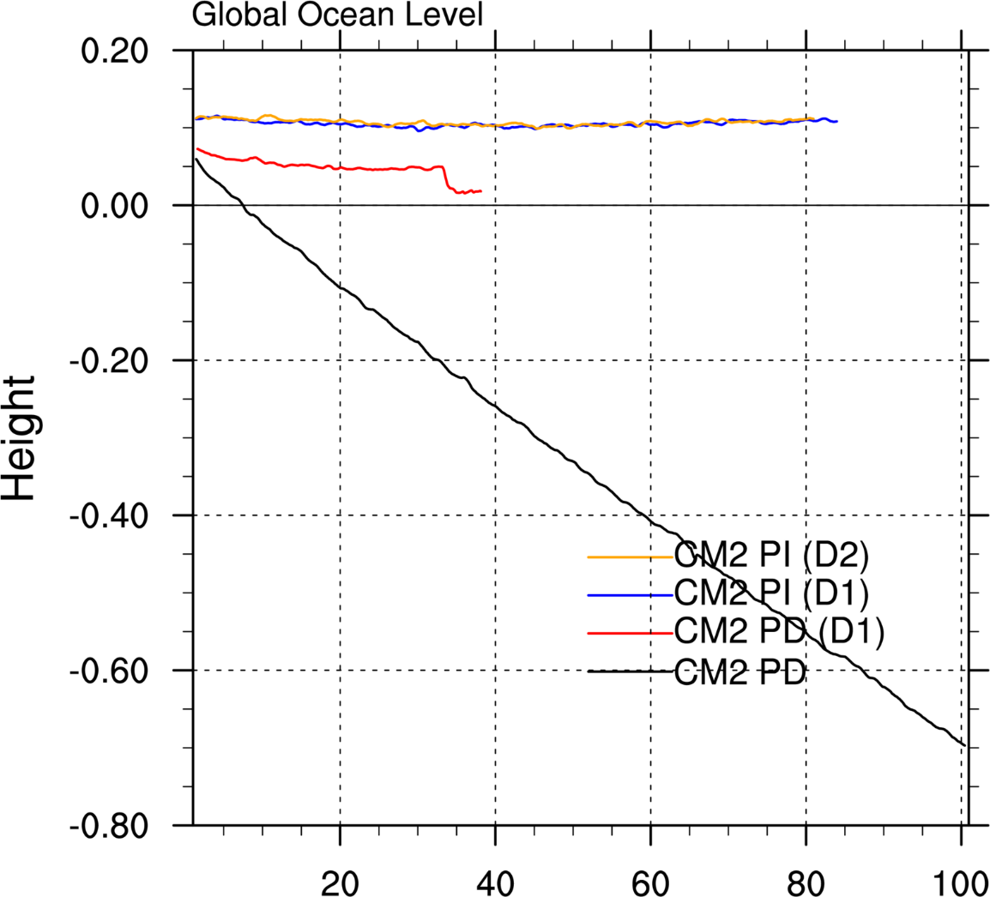
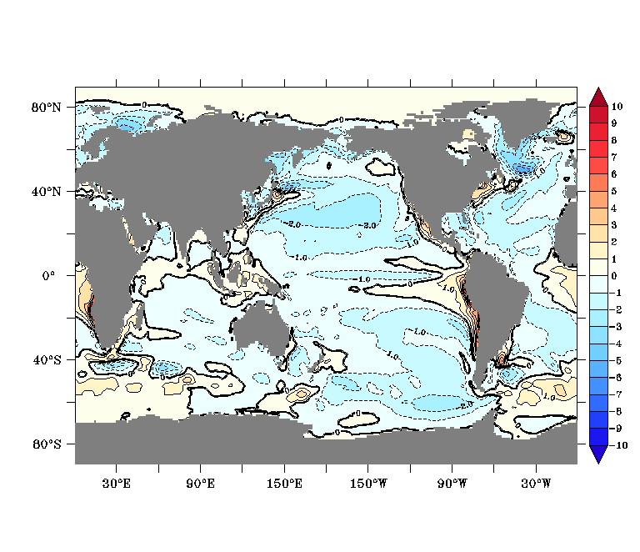
Long-existing issues: SO Warm Bias/little summer sea ice, Water Mass Imbalance
ACCESS-CM2 with GA7 (PD run 30-yr mean)
ACCESS-CM2 with GA7.1 (PD run 30-yr mean)
Av630 –D2

Slide 3
“Fixing” the Southern Ocean Warm Bias and Global Ocean Water Loss (following the UK Met office approach)
By
Discharging the diagnosed increment of iceshelf mass over Greenland and Antarctica into ocean surface water off Greenland and Antarctica, respectively, the land ice melting (as iceberg calving and ice shelf basal melting) ➔
freshening the surface water
cooling the surface water

Slide 4
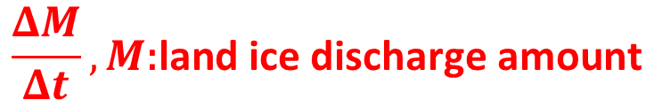
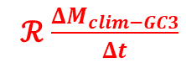
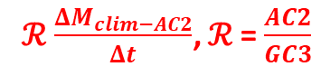
Iceberg Discharge Scheme Setting:
$$\frac{ΔM}{Δt}, M\text{:}\text{land} \text{ice} \text{discharge} \text{amount}$$
D(0): iceberg = 0:
“prescribed” even distribution but time-varying land ice discharged into oceans around Antarctica and Greenland as “iceberg melting”;
D(1): iceberg = 1:
use land ice discharge diagnosed from ar676 (D(0) run, (yrs2-101) imposed on GC3.1 iceberg flux pattern but with each month "enhanced" by the AC2/GC3.1** discharge ratio.
D(2): iceberg = 2:
following GC3.1 iceberg pattern and seasonality, with each month enhanced by the annual ratio of AC2/GC3 “discharge”
Note this option has opposite seasonality to D(0) and D(1), as shown below.
** NEMO standalone iceberg flux climatology.
ℛ$\frac{ΔM_{clim−AC2}}{Δt}$, ℛ = $\frac{AC2}{GC3}$
ℛ$\frac{ΔM_{clim−GC3}}{Δt}$
Notes:
D(1) and D(2) have identical annual discharge amount of land ice, as diagnosed from yrs 2-101 of the D(0) run.

Slide 5
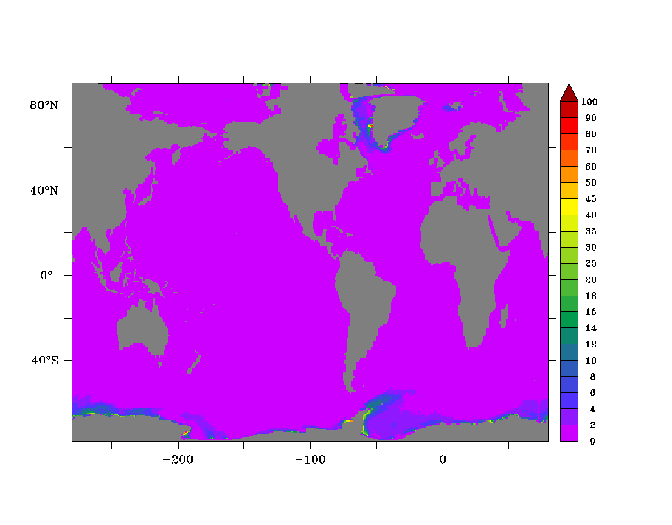
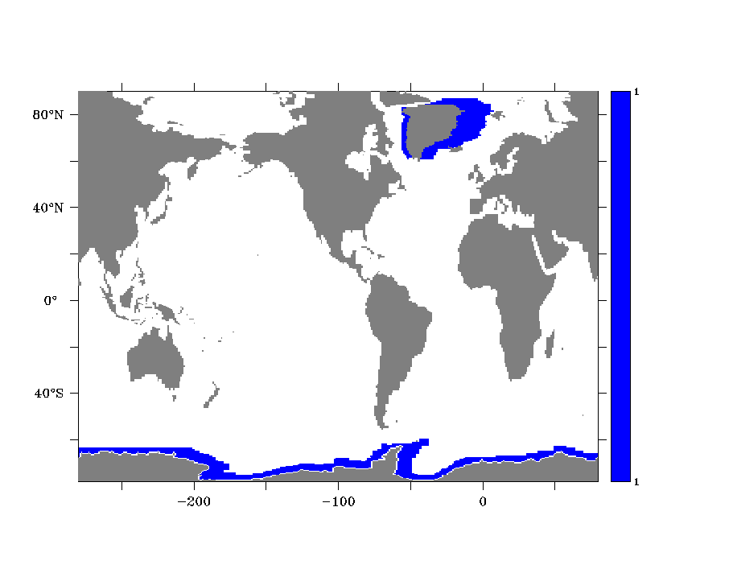
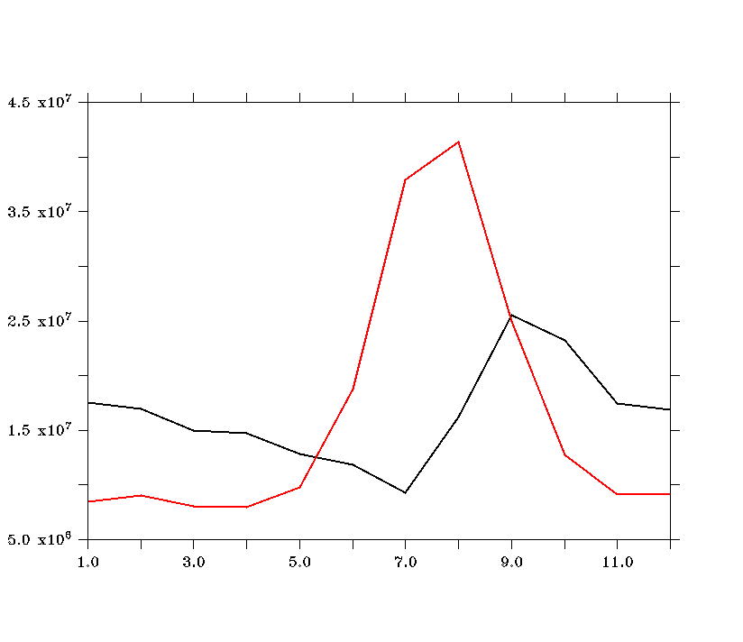
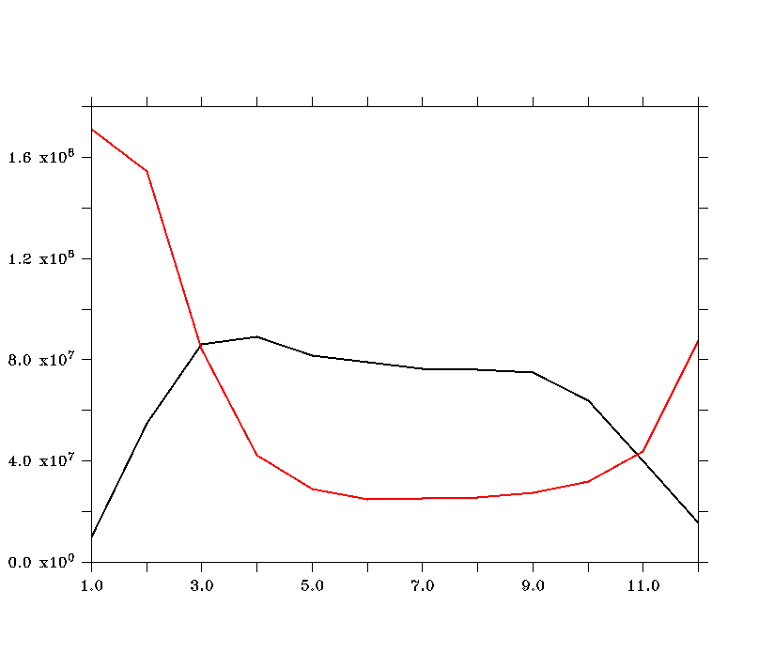
Iceberg Discharge Mask/Pattern and Amount
Ar676
At657 & at658
10⁻⁶ Kg m⁻² s⁻¹
At657 - D1
At658 - D2
Kg/ s
Notes:
Ar676 land ice discharge mask and at657-658 annual mean of land ice discharge rate.
White area
Red UM GC3.1 with NEMO iceberg climatology vs Black line is Ar676 diagnosed land ice discharge annual cycle. The sum of both are equal.
Red is more reasonable.
Refreshing rises the freeze point good for sea ice to form.
Melting will take away the heat which cause major cooling in Southern Ocean.

Slide 6
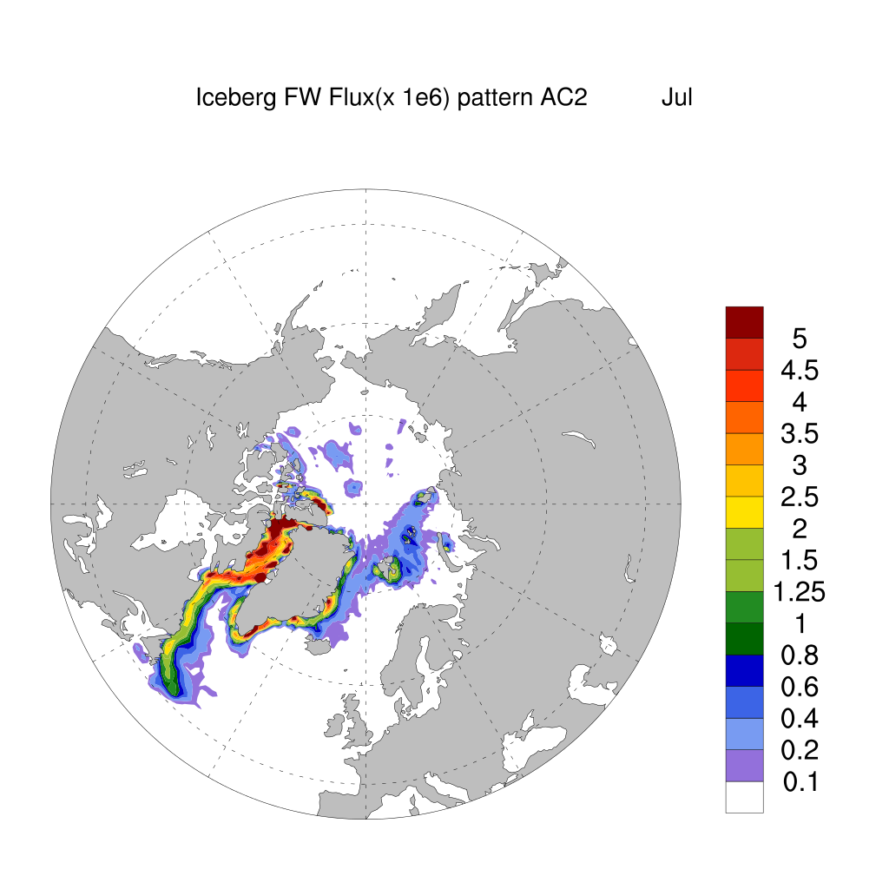
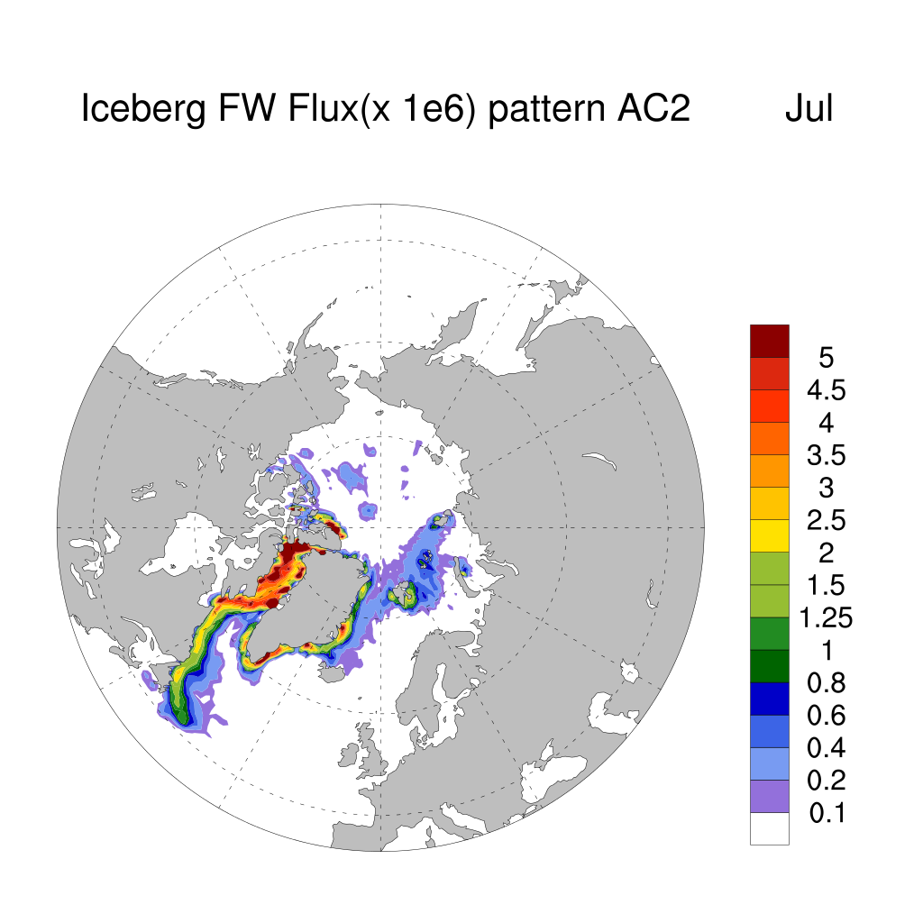
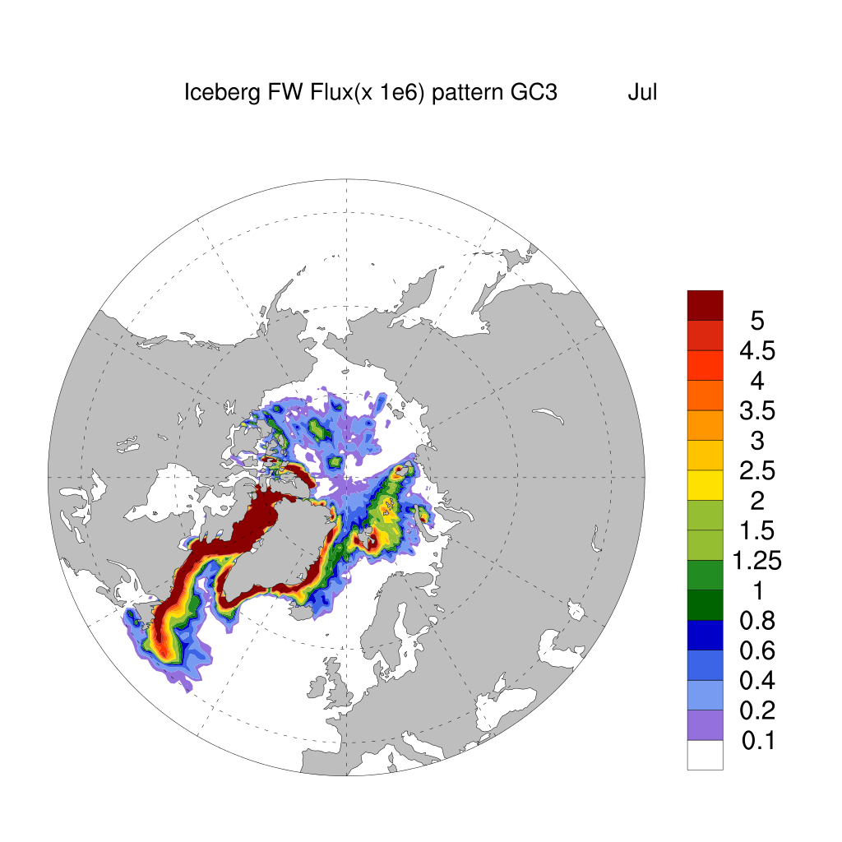
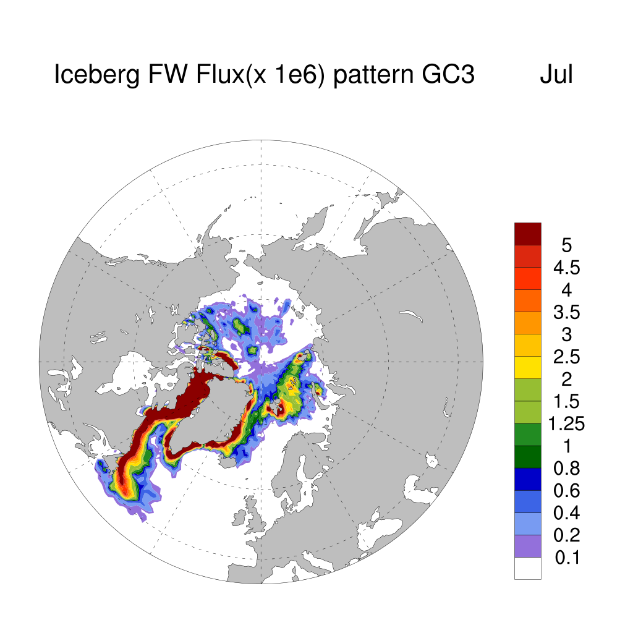
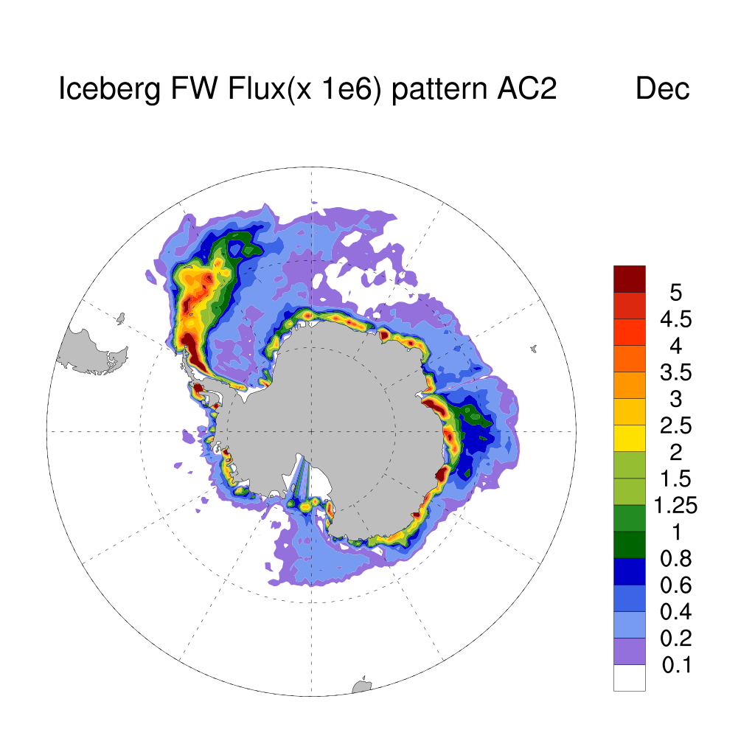
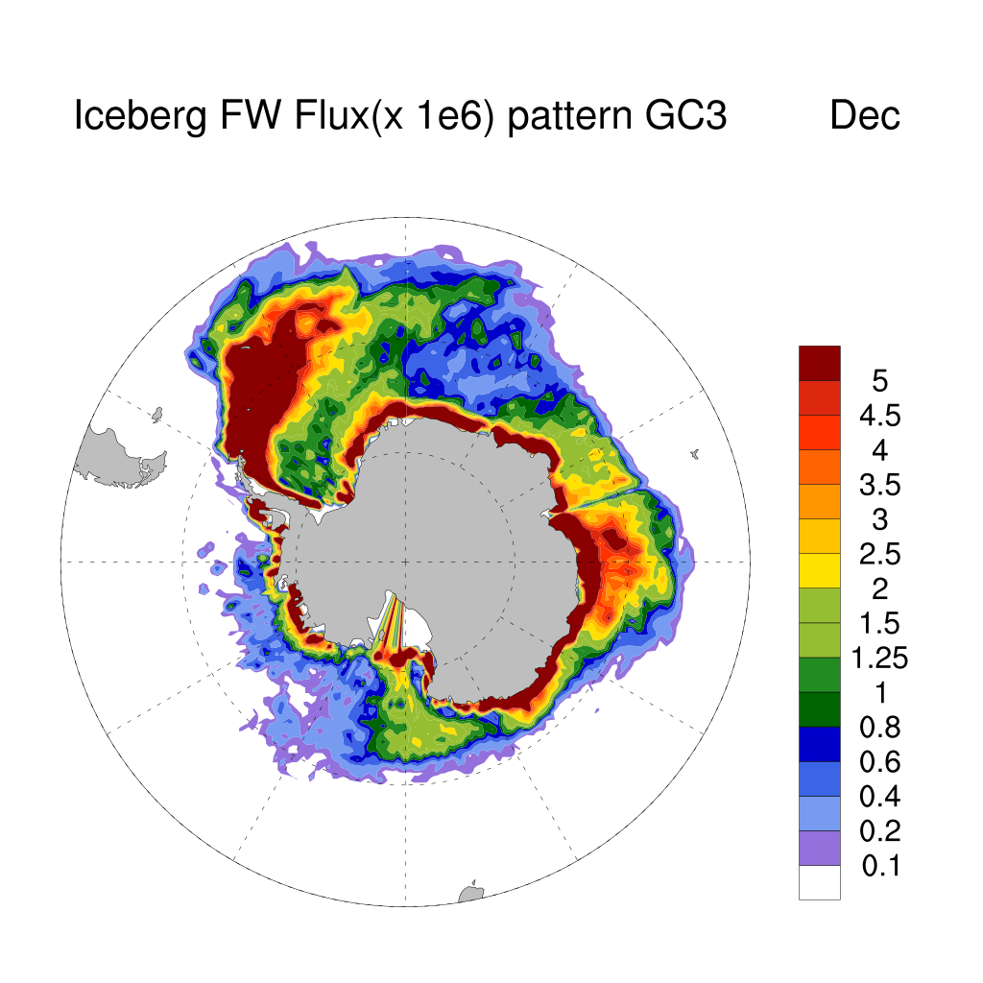
Iceberg flux patterns from option D1 and D2 for NH July and SH December.

Slide 7
ACCESS-CM2 runs included in talk
Ar676 – Uniform (“instantaneous” flux diagnosed from UM land ice increment) land ice discharge around Antarctica and Greenland (discharge scheme 0, D(0)). 1-200 years;
At658 – Land ice discharge following NEMO iceberg distribution (monthly pattern)
– but with ar676 yrs2-101 discharge rate (discharge scheme 2, D(2)).
– ongoing; (from year 0083 the ocean model MOM is reconfigured with reduced tropical background diffusivity)
Av630 – New run continuing ar676, namely, warm start, from year 201 with at658 setup (i.e., D(2))
– and tropical ocean background diffusivity reduction. ongoing > 400 years
Av853 – Based on at658 setup, with sea ice code/namelist “updated” for CMIP6. 100 years

Slide 8
Response of sea ice to iceberg flux scheme
It got colder, so there was an increase in NH ice volume, involved retuning of ice/snow albedos with a reduction of 5% to retain realistic Preindustrial ice extents and thickness this was done in short 30 year runs longer 200+ year runs showed greater ice loss. Also reduced snow conductivity (Met office had done as well)
Major impact was improvement in SH sea ice cover.
Annual cycle improvement in Pre-industrial runs following introduction of iceberg scheme

Slide 9
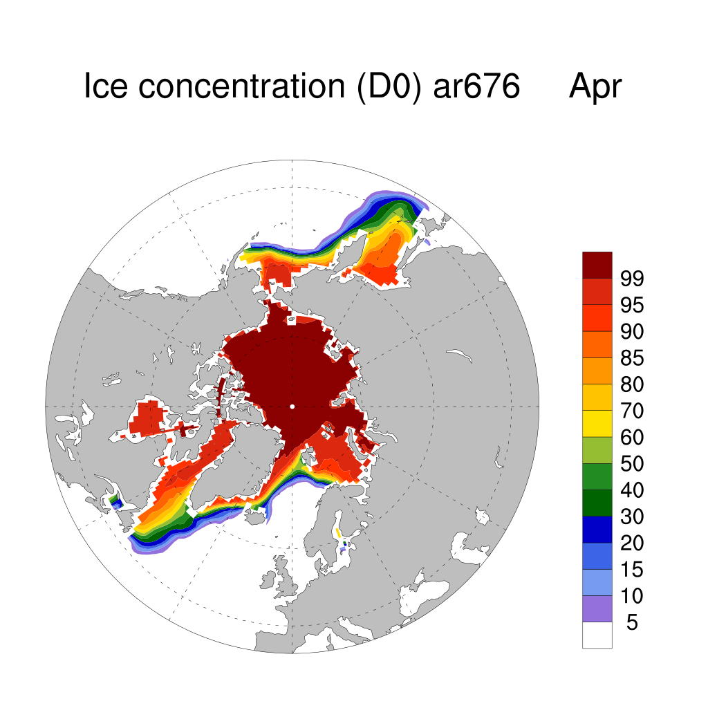
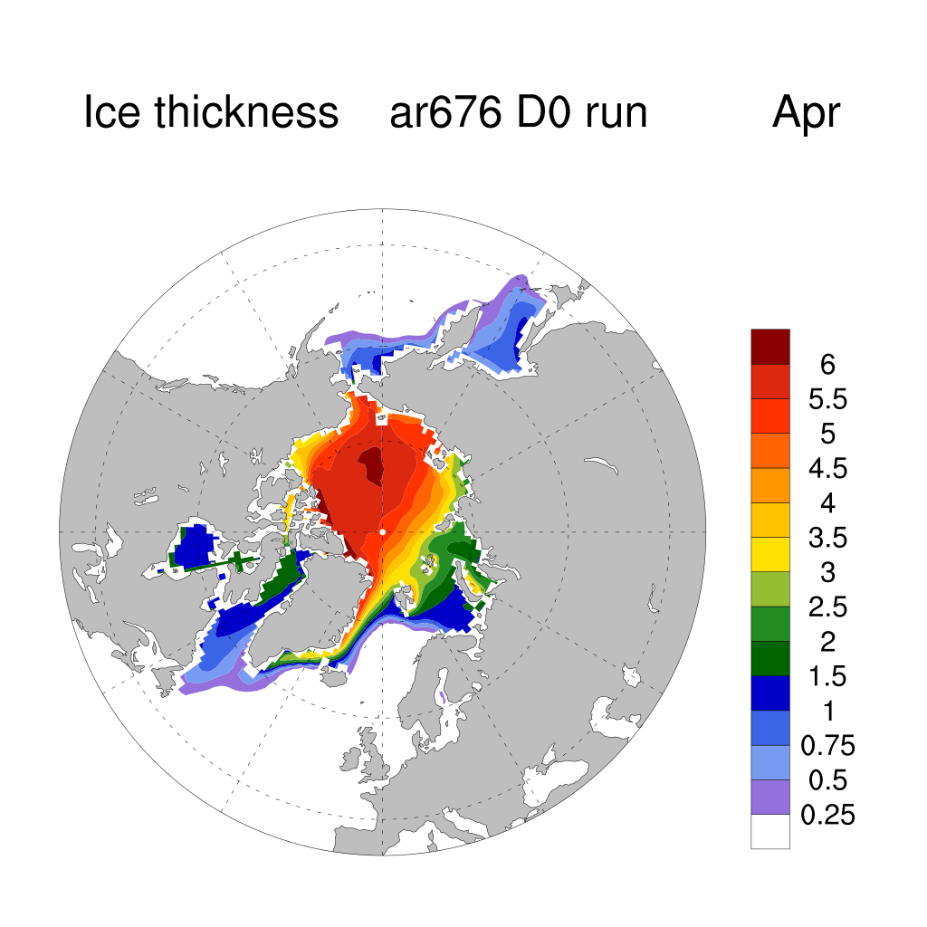
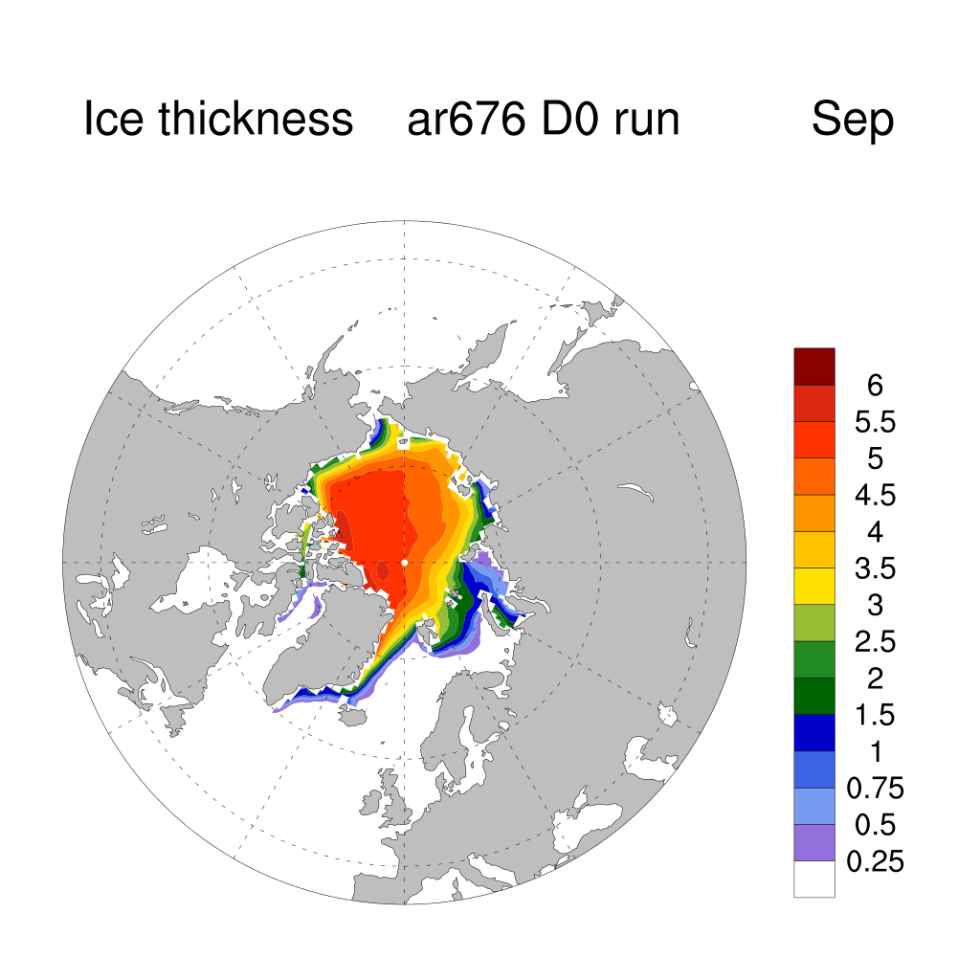
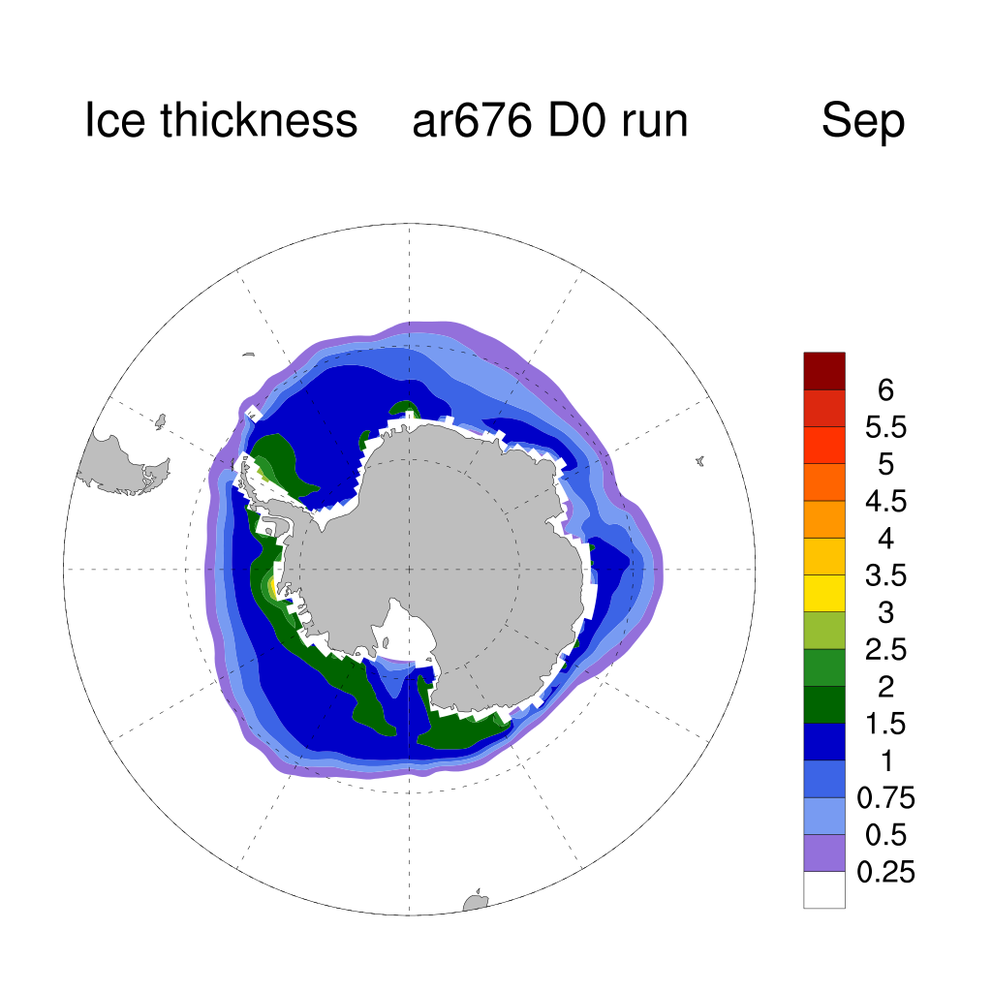
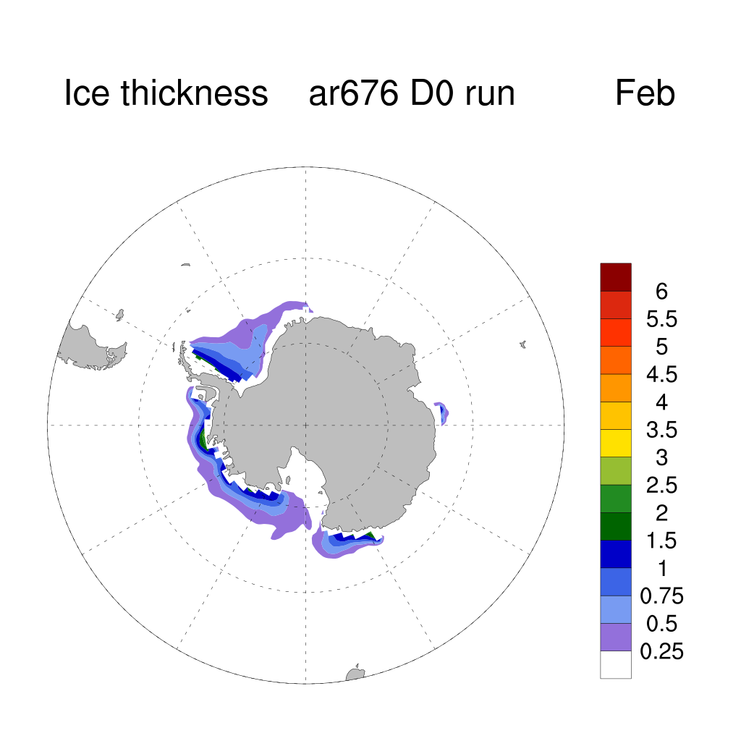
Ice thickness climatology (yrs 191-200) in D0 (fixed iceberg pattern) simulation before albedo adjustments.

Slide 10
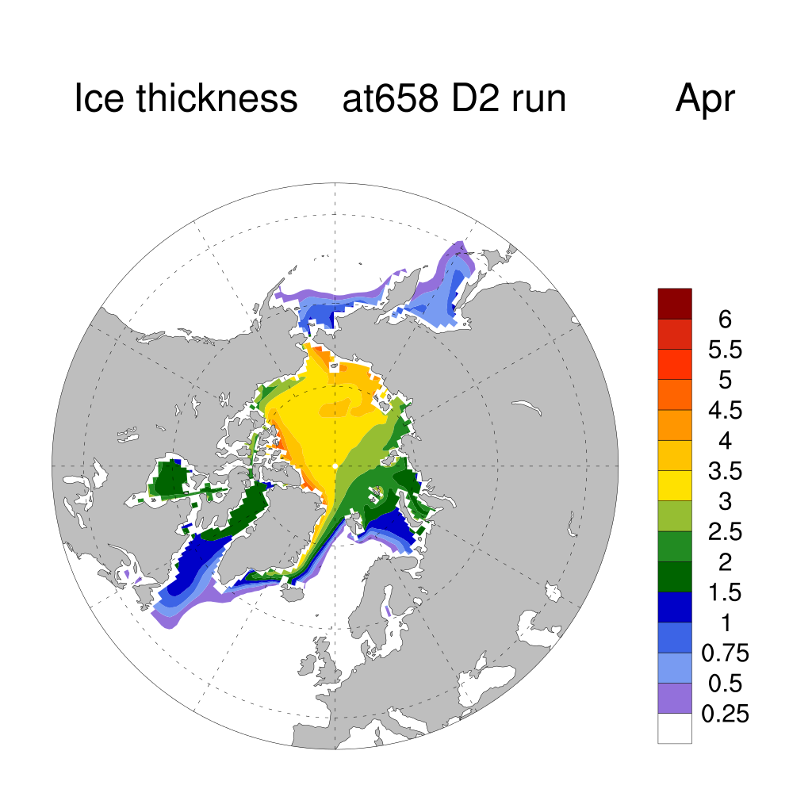
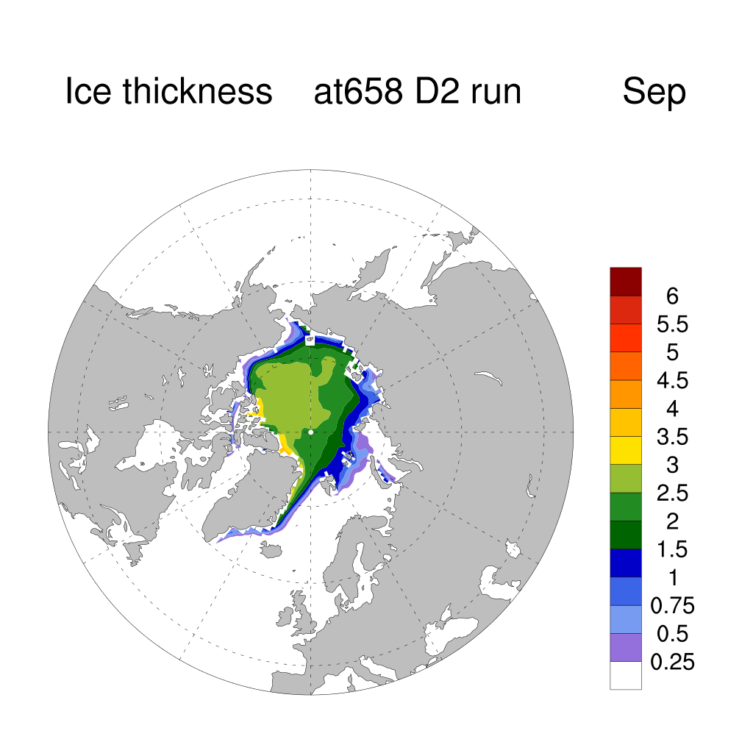
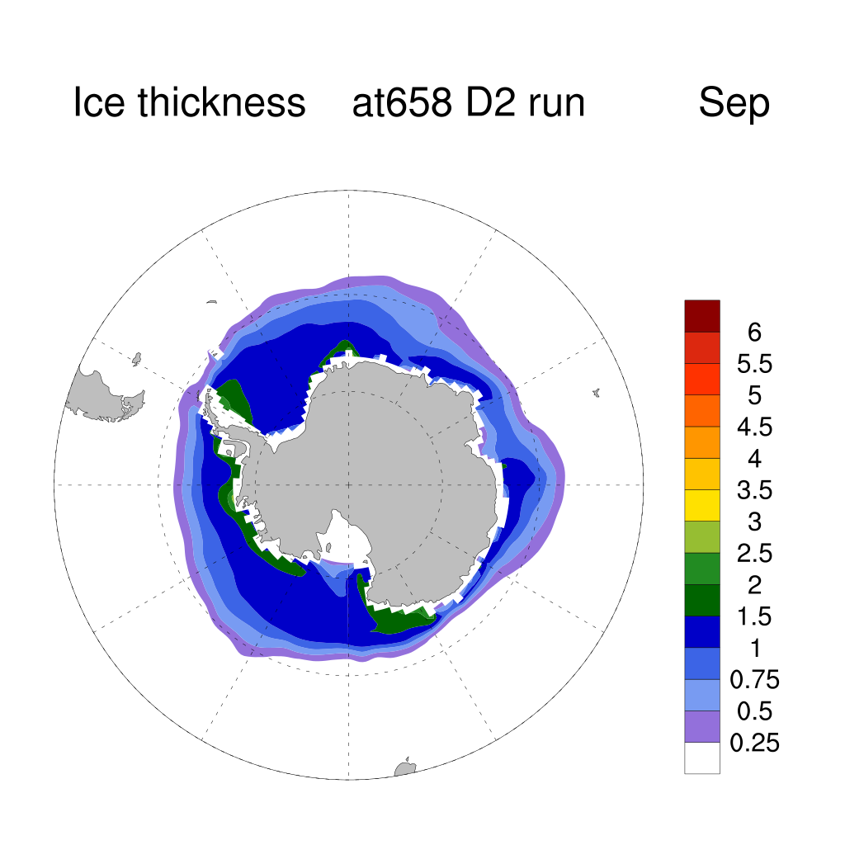
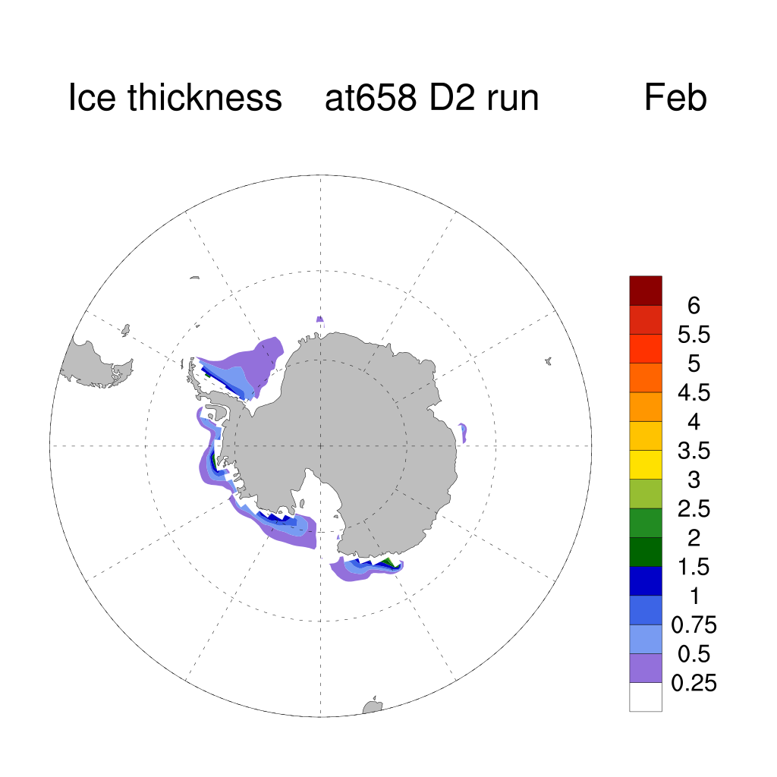
Ice thickness climatology (yrs 191-200) albedo change implemented with D2 iceberg flux pattern.

Slide 11
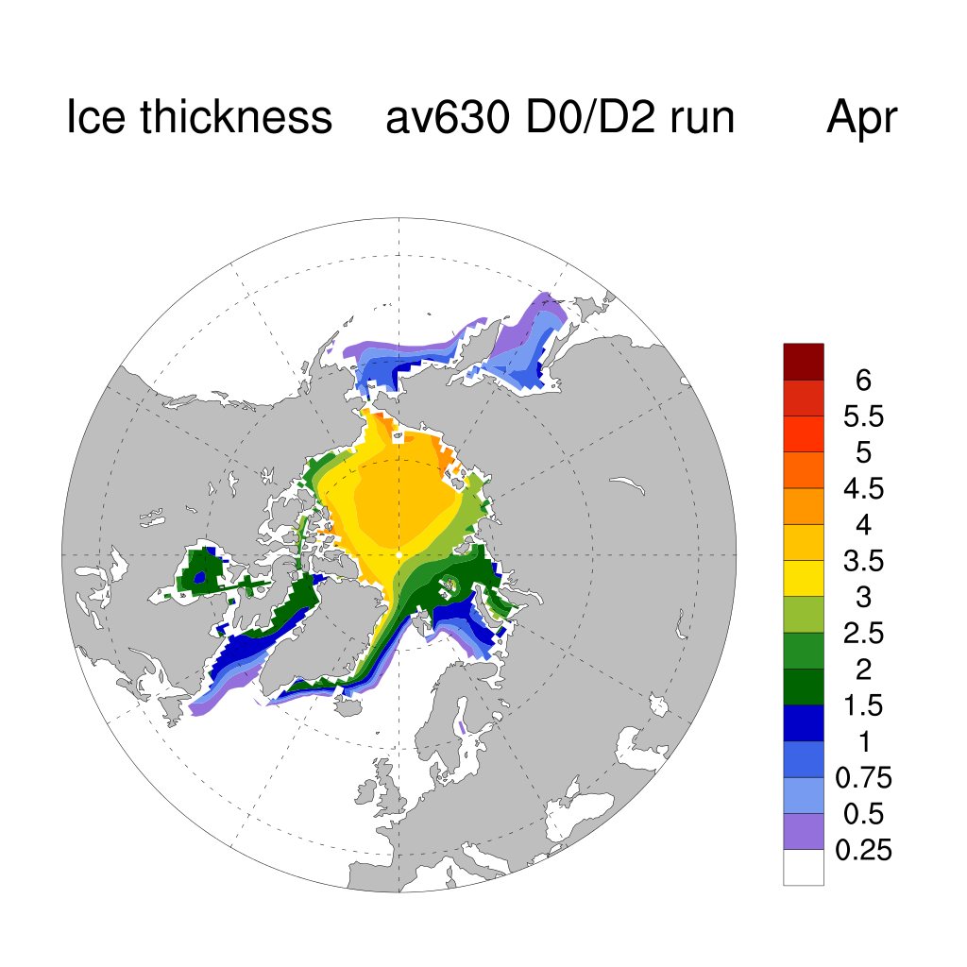
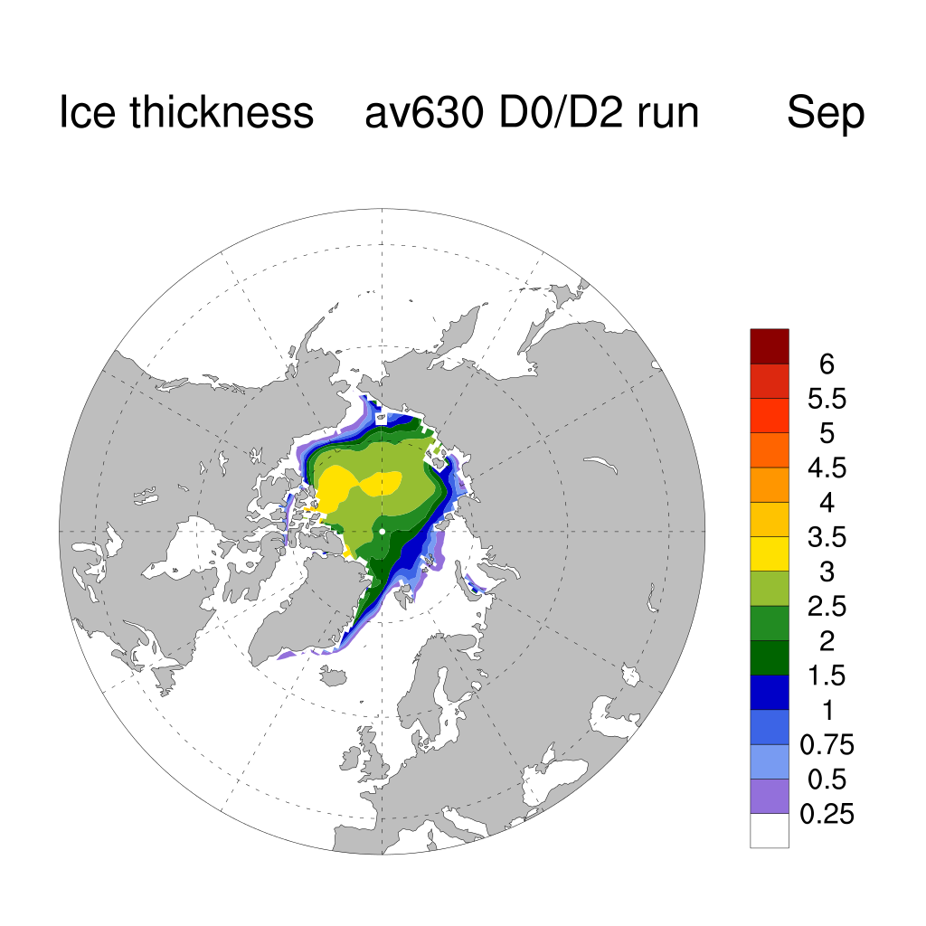
Ice thickness climatology in warm start run (yrs 391-400) 200 years after albedo change and D2 flux pattern switched on.

Slide 12
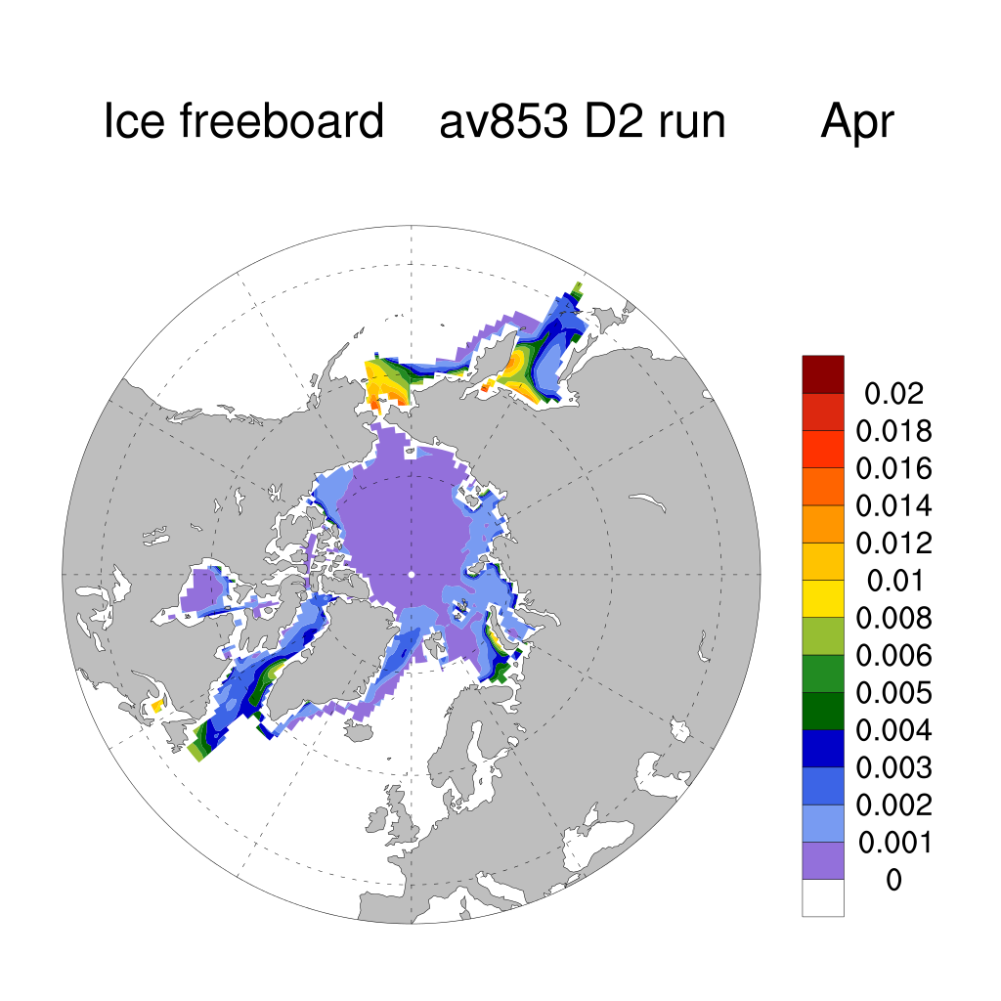
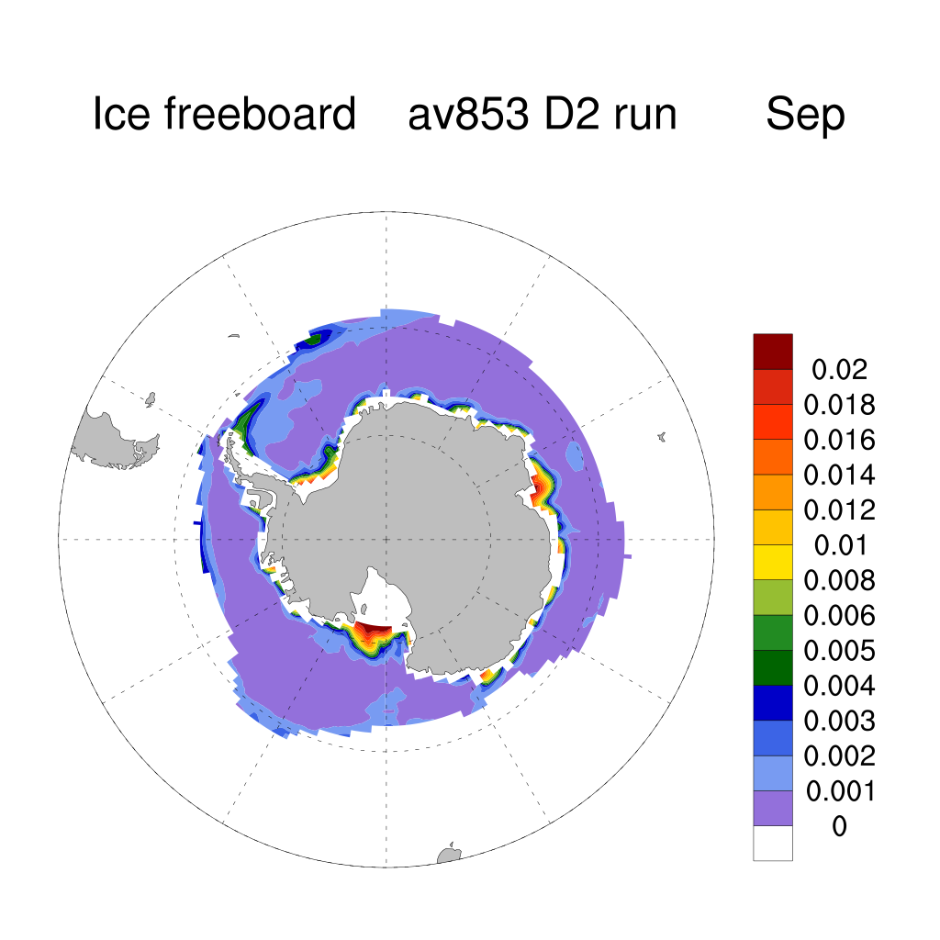
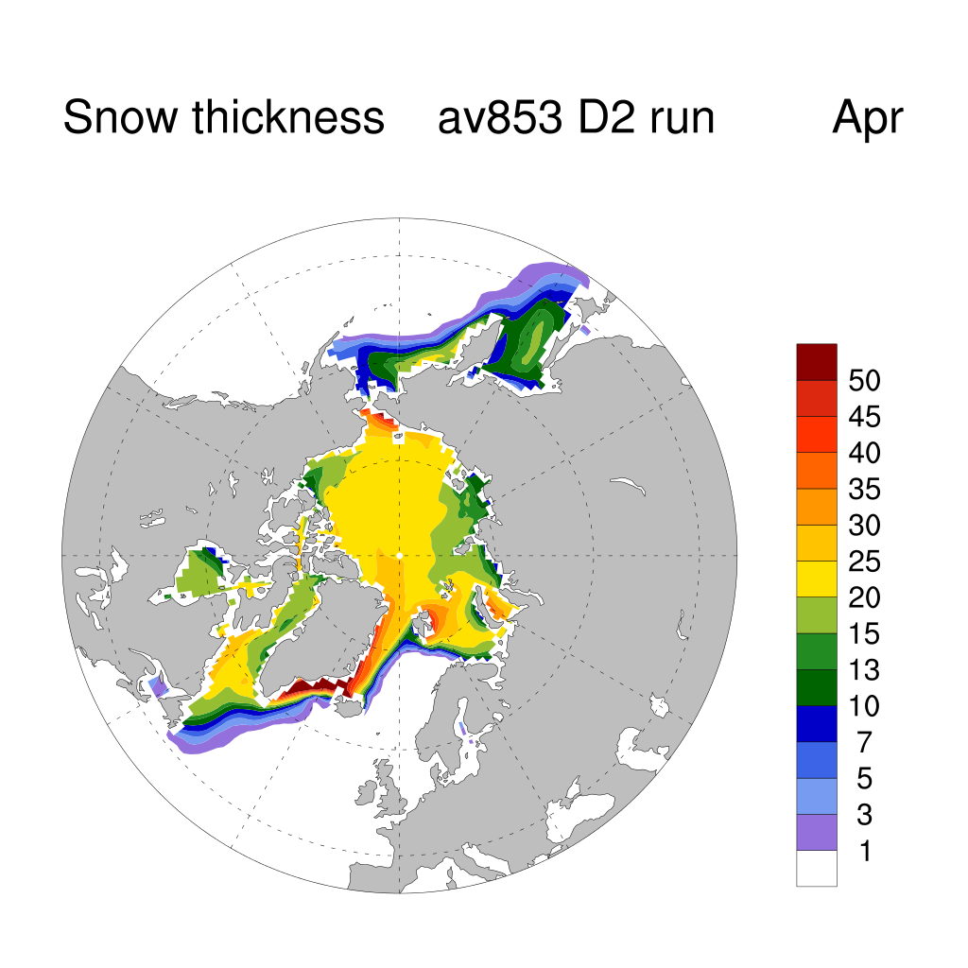
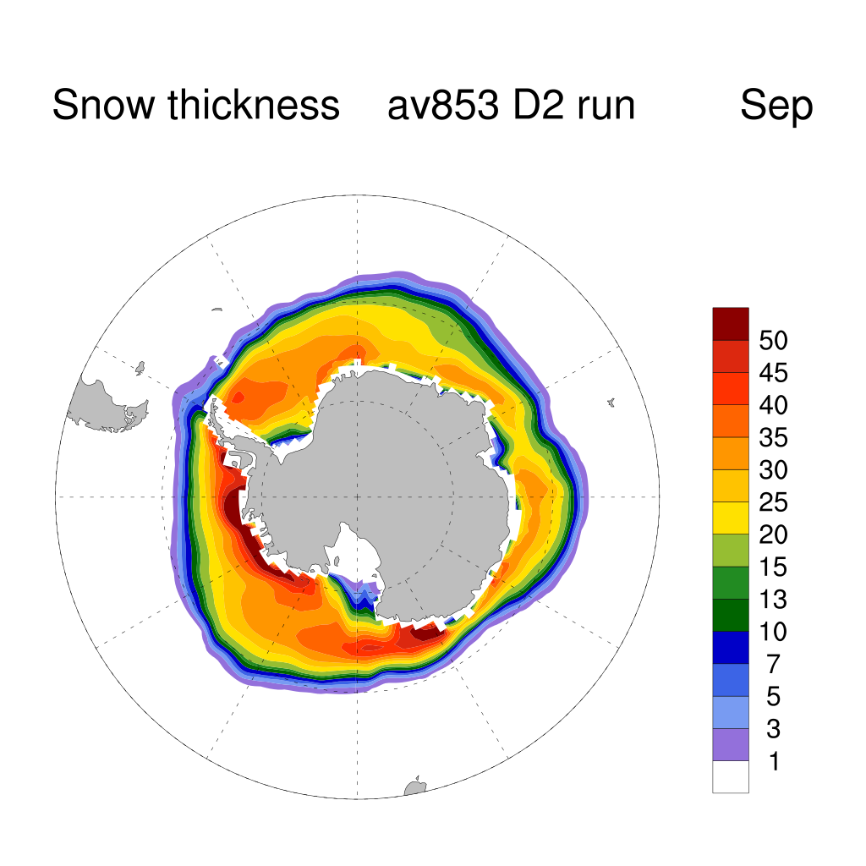
Run with CMIP6 output mostly renaming/re-weighting exiting fields. New one ice freeboard to compare with satellite altimeters, note poor data in Antarctica due to heavier snow cover.

Slide 13
Summary
Sea ice is close to ready for CMIP6 with new variable names in the code and namelists.
The climatology is realistic in both hemispheres.
Some final tuning may be required once we have longer CABLE runs based on our experience with ACCESS1.3 where we saw ice declines due NH temperature bias.

